Slide 1
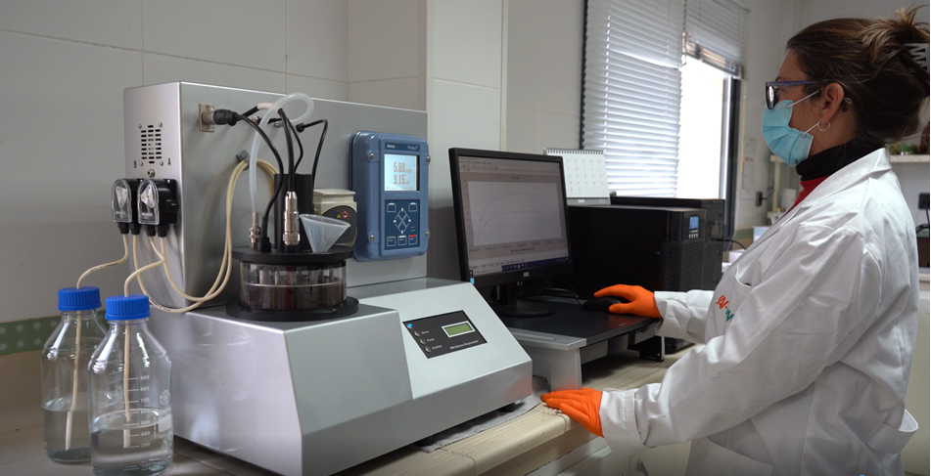
BM Respirometry
https://www.youtube.com/watch?v=UeMvk7U5ZMo

Slide 2
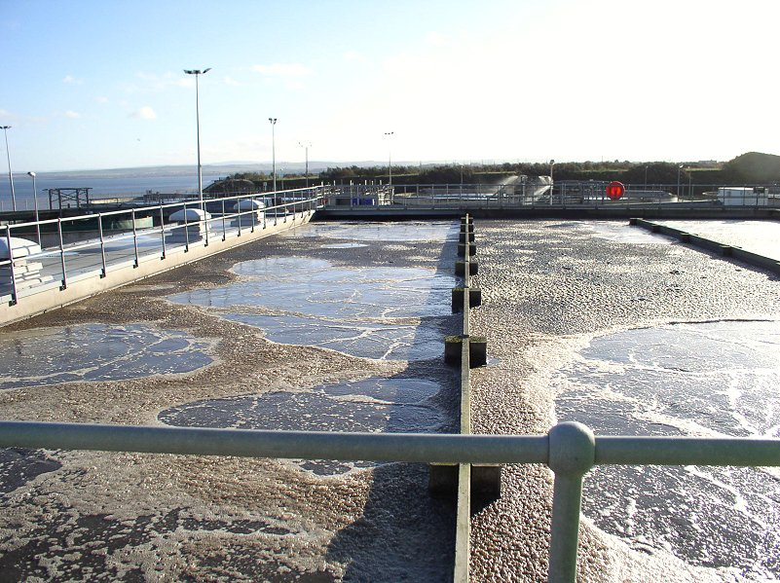
What is BM Respirometry?
It is a technology designed by SURCIS that combines the traditional Respirometry with a state of the art method that permits to carry out different types of tests on a fast and simple way to measure the oxygen uptake and derived parameters from the microorganisms of the activated sludgein any biological wastewater treatment plant.
BM - Respirometry can work on different combinations:
Activated sludge
Activated sludge + wastewater sample
Activated sludge + any sample
Activated sludge + standard compound
...

Slide 3
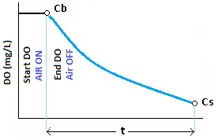
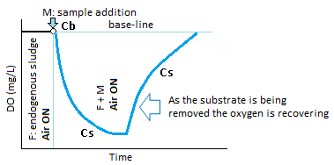
Main versions of the oxygen uptake rate
Oxugen uptake rate = OUR, Rs
Static oxygen uptake rate: OUR = (Cb – Cs) / t
(aeration → no-aeration)
Dynamic oxygen uptake rate: Rs = K (Cb – Cs)
(permanent aeration)
Specific oxygen uptake rate: SOUR, Rsp
SOUR = OUR / SSV
Rsp = Rs / SSV
Cb, Cs: Oxygen values at start and in-progress.
F: Actuvated sluge
Endogenous: without any substrate
ML: Mixed-liquor
M: Sample (wastewater, compound, stream, ...)

Slide 4
Where the BM respirometers can be used ?
In any biological wastewater treatment plant (WWTP) | The BM can be installed in the Laboratory of the plant for its management
In a central laboratory | The BM is installed in a central Lab on the aim to offer its service for samples coming from different WWTP or to assess any industrial wastewater.
In a University or Research center | The BM is installed in the Lab of the Research Centre or University
For different WWTP as easy trasportable (only BM-T+) | The BM is moving to the WWTP and installed in the Lab or working bench
BM respirometer
WWTP1
WWTP1
WWTP2
BM respirometer
Research
Follow-up
Design
Assessment
University
R &D Center
BM respirometer
BM respirometer
WWTP1
WWTP2

Slide 5
Some applications in BM Respirometry
Oxygen requirement and energy optimization
Bioaugmentation control and tracking
COD fractions: Automatic rbCOD, bCOD, Calculation of nbCOD and sbCOD
BOD5 estimation
Analysis of the Influence of different conditions (pH, Temp., Oxygen, ...) in the process
Operative parameter optimization: SRT, F/M
Nitrification rate – Nitrification capacity
Denitrification rate - soluble bCOD necessary for denitrification
Anoxic - Anaerobic process (in BM-Advance Pro)
Global Toxicity referred to one specific biomass
Specific Toxicity to nitrification
Kinetic parameters
Support for simulation programs
Many others
BM respirometers are open systems support all kinds of combinations
to step into an endless number of applications.

Slide 6
BM respirometry systems
https://youtu.be/UeMvk7U5ZMo

Slide 7
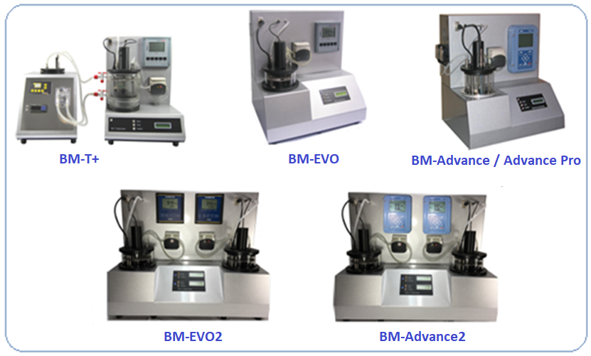
Multi-purpose Respirometers BMTM Series
BM-Respirometers are laboratory analyzers specially developed for practical and efficient biological wastewater treatment management, design and research

Slide 8
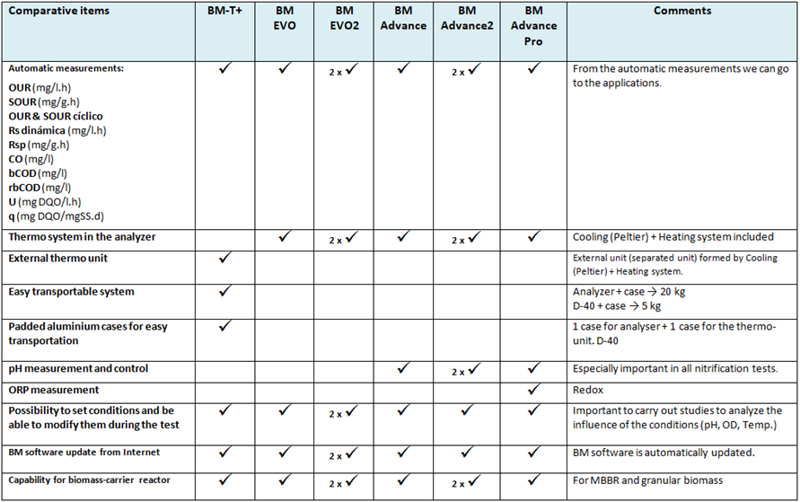
Comparative table of BM respirometers

Slide 9
BM
operation modes

Slide 10
Operation modes and automatic parameters
OUR: Oxygen Uptake Rate (mg O₂/l.h)
It measures the oxygen uptake rate for only one measurement or serial o measurements.
SOUR: Specific OUR (mg O₂/g VSS.h)
Specific OUR related to MLVSS. SOUR = OUR / MLVSS
OUR & Cyclic OUR
modes
BM Respirometry Operation Modes
Rs: Dynamic Respiration Rate (mg O₂/l.h)
It measures the oxygen uptake rate from the mixture of the activated sludge and certain amount of wastewater sample or compound within a continuous chain of measurements.
Rsp: Dynamic specific respiration Rate (mg O₂/g VSS.h)
Specific Rs referred to MLVSS. Rsp = Rs / MLVSS
bCOD: Biodegradable COD (mg O₂/l)
Biodegradable or soluble readily biodegradable COD fraction, based on Rs measurements integration from a mixture of activated sludge and biodegradable sample.
U: COD removal rate (mg COD/l,h)
Speed at which the COD is being removed.
q: Specific COD removal rate (mg COD/ mg VSS.d)
Specific U referred to MLVSS concentration.
R
mode

Slide 11
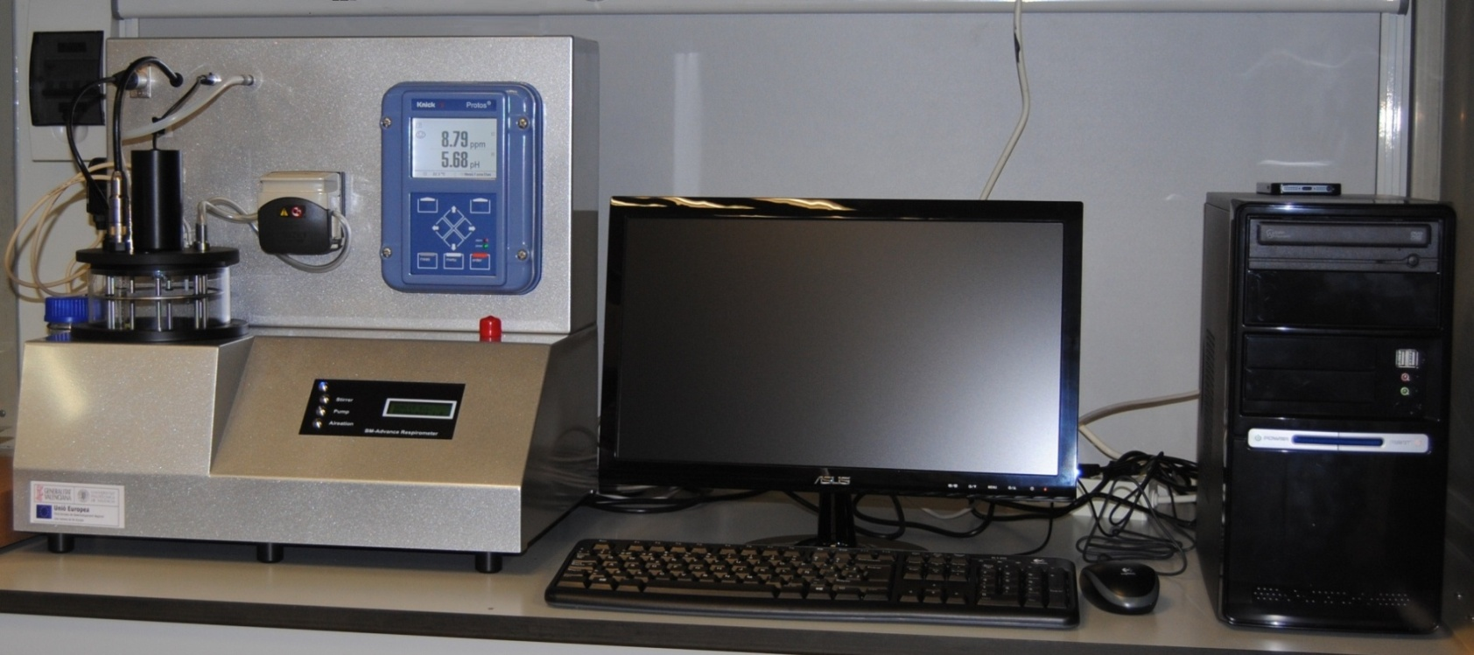
BM Advance Respirometry system

Slide 12
Key points of the components
and control systems included in the BM - Respirometers

Slide 13
List of some key points concerning the components and systems included in the BM respirometers that make the difference
Direct oxygen measurements from a maintenance-free oxygen sensor
No oxygenation restriction during test performance
pH control system in the BM-Advance system
pH control and ORP measurements in the BM-Advance Pro system
Automatic solid-state device for heating & cooling
Option for a special reactor assembly to simulate a Moving Bed Biofilm Reactor (MBBR)
Double reactor in model in BM-Advance2

Slide 14
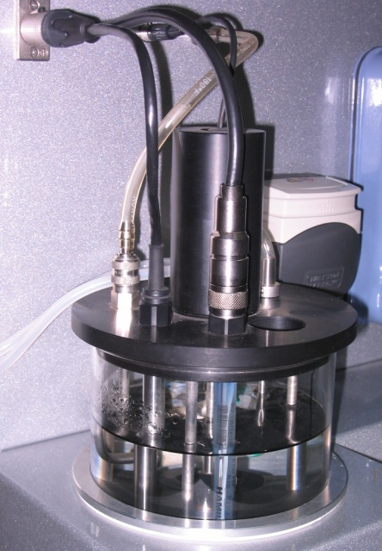
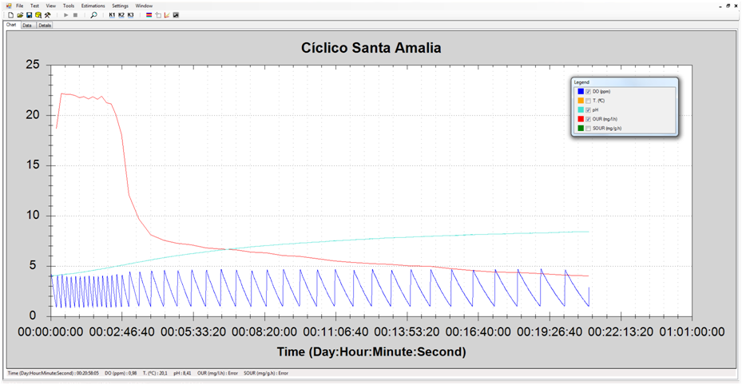
No oxygenation restriction during test performance
The air supplied to the reaction vessel comes from a small compressor which can be controlled in the settings board by fixing the percentage of the total air-flow.
Air supply
Air difusser
Reactor assembly
Respirometry Cyclic OUR test of more than 20 h

Slide 15
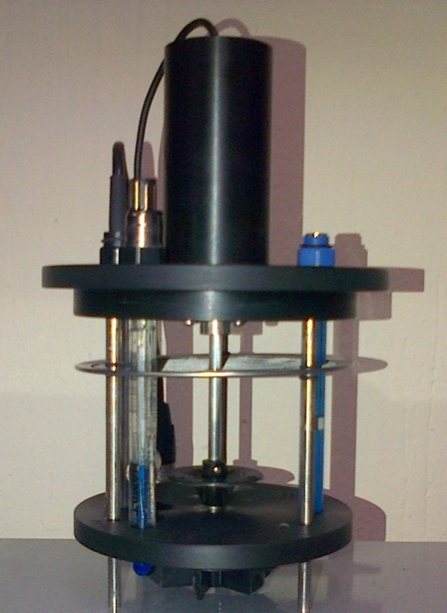
High reliability Sensors
DO sensor
40 ppb to saturation
0 – 60 ºC
Electrochemical oxygen sensor
Patented OPTIFLOW membrane – specially dsigned for harsh ambient -
100% maintenance-free sensor: membrane and electrolyte don’t need to be replaced.
Response time is fast and independent of flow.
Very stable under harsh ambient conditions.
DO sensor
pH sensor – Advance and Advance Pro models
pH 0 to 14
0 – 135 ºC
Almost drift-free measurement.
Reference electrolyte factory prepressurized for a clog-free diaphragm potentials.
Everef-F Reference cartridge for silver-free electrolytes.
Poison resistant “PHI” pH glass.
pH sensor
ORP sensor – Advance Pro model
Set to -1000 mV to + 1000 mV
0 – 130 ºC
ORP element: Pt wire
Maintenance-free sensor.
High-performance ceramic diaphragms to reduce the effect of flow potentials.

Slide 16
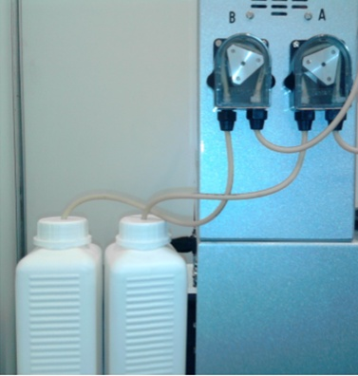
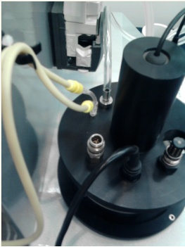
pH control in the BM-Advance models
Peristaltic pumps
for buffers dosing
Hole for buffer
tubes insertion
pH control system
Automatic pH buffers dosage in the reactor

Slide 17
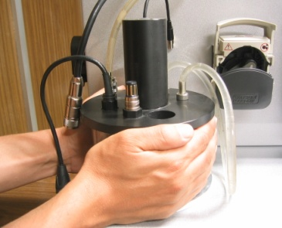
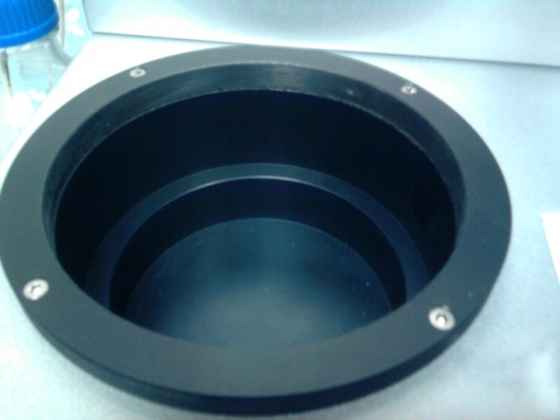
Automatic heating-cooling system
Solid-state system based on peltier technology for temperature control (heating & cooling). This heating and cooling system is built into the same analyzer console without the need of using any water bath.
Reactor is carried to the heating-cooling site
Heating-cooling assembly

Slide 18
Optional reactor for MBBR
BM respirometers are the only respirometers on the market that can offer the possibility of making use of one special bio-reactor assembly (designed by Surcis) for respirometric tests simulating moving bed bio-film reactors (MBBR type) or granular biomass.
Biomass-carriersot granular loading
in the reactor-cage
Biomass-carriers + mixed-liquor
loaded in the reactor vessel
Reactor installed in the system
and ready for the test performance

Slide 19
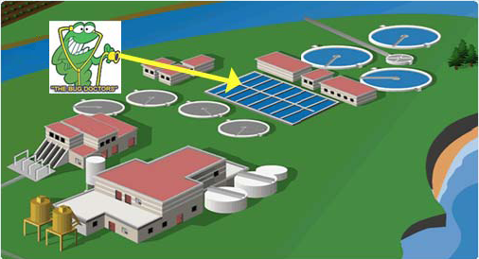
BM Respirometry
Applications

Slide 20
Primary assessment of the activated sludge process

Slide 21
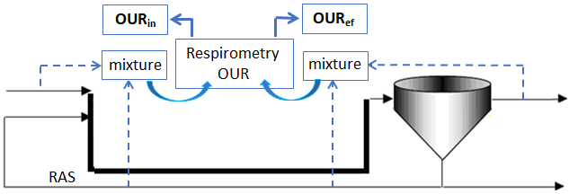
Taking the pulse of the process performance
Loading Factor: LF = OUR_{in} / OUR_{ef}
LF | Assessment
LF < 1,3 | Inhibition / Toxicity already present in the reactor
1,3 < LF < 3 | Low process performance
3 < LF < 5 | Good process performance
LF > 5 | Overloading
This is an easy and fast way to evaluate the actual performance of the process without the need to resort to any other Lab parameter.

Slide 22
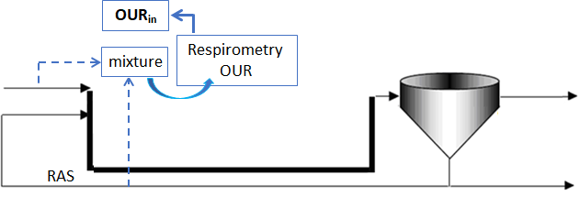
Follow up for maintenance or elements replacements
in the aeration system
This application is based on the principle that the OUR_{in} is proportional to the inlet load and that to maintain a determined performance there must be a balance between the inlet load and the air flow that is supplied for determined process performance and DO.
AF = Q_{air} / OUR_{in}
AF (average) for a determined performance | Valoración
Going up progressively | Lack of maintenance or elements replacement in the aeration system
Remains constant (+/- 10%) | In order
Going dow progressively | Energy may be wasted by excessive aeration

Slide 23
Endogenous respiration

Slide 24
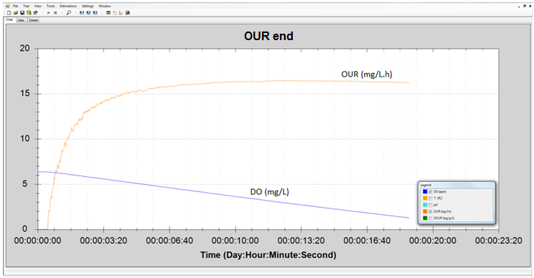
Endogenous respiration rate
It is about the endogenous oxygen uptake rate test (OUR end) of the activated sludge after being aerated for a sufficient time to eliminate any kind of degradable subtrate.
Normally the endogenous respiration state can be recognized when the oxygen readings are stable within its oxygen saturation level.
DO and OUR respirogram for OUR end

Slide 25
OUR_{end} assessment
Table guide of usual OUR_{end} values
MLVSS (mg/l) | OUR_{end} (mg/l.h)
1000 | 2 – 3.5
1500 | 3 - 5
2000 | 4 - 7
2500 | 5 – 8.5
3000 | 6 - 10
3500 | 7 - 12
4000 | 8 – 13.5
4500 | 9 – 15.5
Some reasons for which the OUR end value could be below its normal range
Low active biomass concentration
Any of the current process conditions (or several) is out of the normal range: Temperature, Oxygen, pH, Nutrients,…
Too high % of slowly biodegradable COD (sbCOD) in total COD → Biomass starvation
Toxicity already present in the biological reactor

Slide 26
COD
fractions

Slide 27
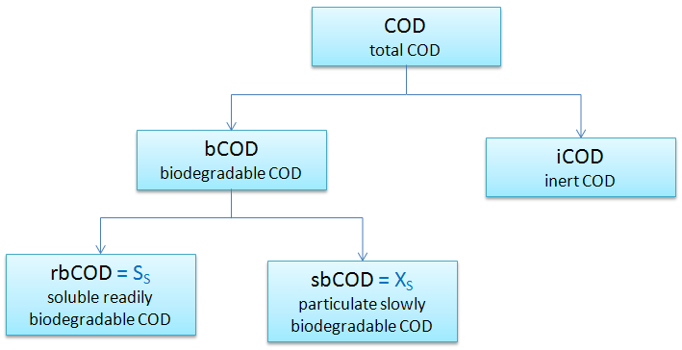
Main COD fractions (1)

Slide 28
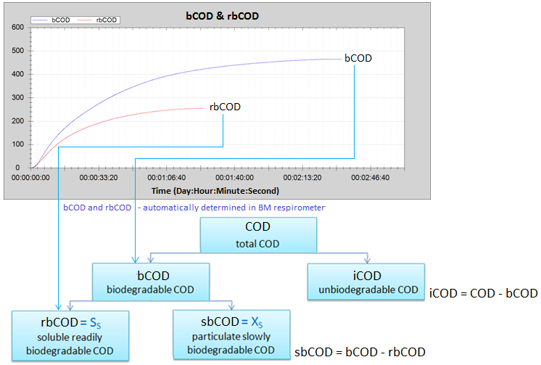
Main COD fractions (2)
Normally with only two R tests - for bCOD and rbCOD (soluble sample) – , together with the total COD value, we can determine the main COD fractions

Slide 29
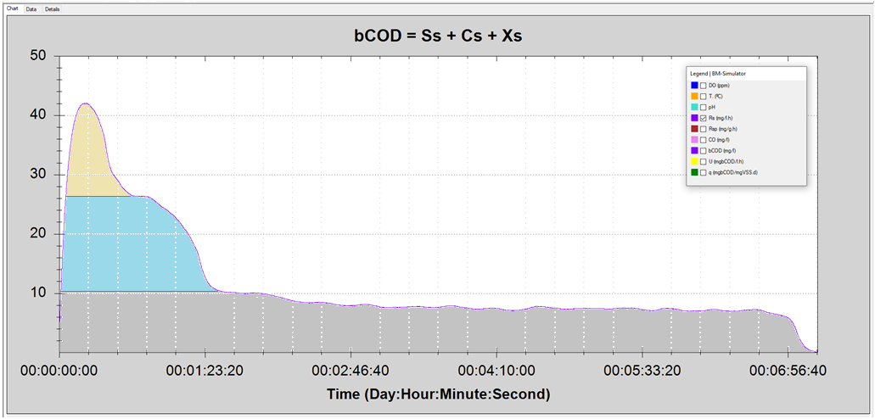
COD fractions in one single R test
Where that is the case, within a single R test and by making use of one of the software options, it is possible to determine the bCOD fractions by breaking down the different corresponding areas.
S_{S}
C_{S}
X_{S}
S_{S} : Readily biodegradable COD (mg/l)
C_{S} : Colloidal slowly biodegradable COD (mg/l)
X_{S} : Particulate biodegradable COD (mg/l)

Slide 30
Toxicity

Slide 31
Basically we can see two cases of toxicity
Toxicity already present in the ASP
Potential toxicity in the wastewater or compound that should be analyzed before entering in the ASP

Slide 32
Symptoms for a toxicity already present
in the activated sludge process
FED SOUR: SOUR in mixed-liquor from the process start
UNFED SOUR: SOUR in mixed-liquor from process end (effluent sludge)
Parameter | Condition
FED SOUR / UNFED SOUR | < 1.3
OUR_{end} | << Reference values in Table OURend vs MLVSS

Slide 33
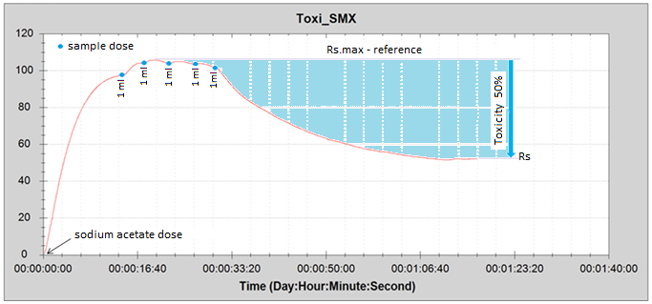
Short term toxicity
The method is based on one R test (using endogenous RAS sludge) where its added a readily biodegradable standard substrate (e.g. sodium acetate) with sufficient concentration to get its maximum respiration and, once this has been achieved, adding sucessive doses of sample to compare the respiration rate in progress with the maximum respiration rate reached in the test (reference)
Rs respirogram for short term toxicity
Toxicity (%) = 100 * (Rs.max – Rs) / Rs.max

Slide 34
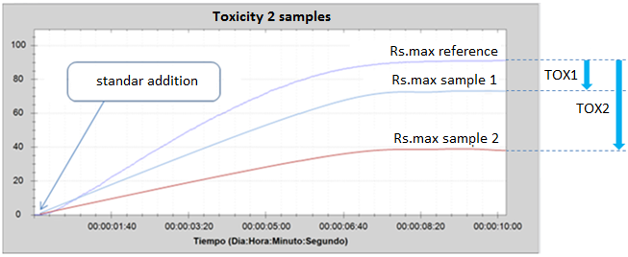
Toxicity for global biomass or specific nitrifier
This method is based on the preparation of one mixed-liquor with RAS sludge + distilled water (reference) and one o several more mixed-liquor with RAS sludge + sample/s to be analyzed.
Mixed-liquors preparation
Endogenous respiration sludge
R test with estándar addition (*)
Rs.max comparison vs Rs.max reference
(*) The method is valid both to analyze a global toxicity (by adding the standar of sodium acetate) or a specific toxicity for nitrification (by adding the standar of ammonium chloride)
Combined Rs respirograms to asses 2 samples toxicity
Toxicity (%) = 100 * (Rs.max ref. – Rs sample) / Rs.max ref.

Slide 35
Nitrification

Slide 36
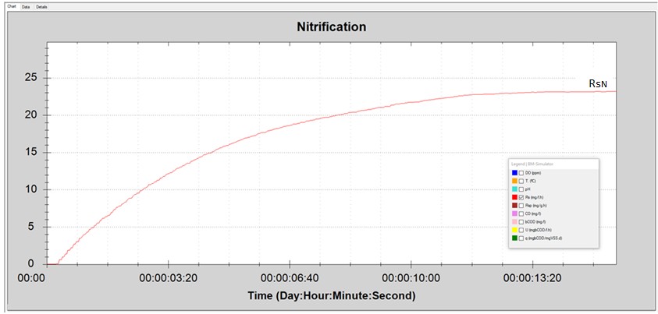
Nitrification rate
We carry out a R test with ammonium chloride on equivalent ammonium concentration, until we reach the representative Rs (Rs_{N})
Rs respirogram
Ammonium chloride addition
Nitrification rate (mg N/l.h): AUR = (Rs_{N} / 4,57) * DO / (K_{OA} + DO)
Rs_{N}: Respiration rate due to nitrification (mg O₂/l.h)
4,57: mg O₂ / mg Ammonium oxidized
DO: Actual dissolved oxygen in the biological ractor
K_{OA}: Nitrification coefficient ≈ 0,5 (habitual default value)

Slide 37
Dissolved Oxygen (DO) and Sludge Age (SRT)
for Nitrification
AUR = [Rs_{N} / 4.57] * OD / (K_{OD} + OD)
SRT = X_{A} / (2.4 * AUR)

Slide 38
Denitrification

Slide 39
Denitrificatio rate: NUR
This parameter is determined by respirometry thanks to the fundamental principle whereby there is a directly proportional relationship between the aerobic rate of oxygen consumption by organic matter removal (U) and the anoxic nitrate removal rate (NUR)
US-EPA, Henze et al 1987 - Illinois Institute of Technology – Andrew Robert Shaw; Heather M. Phillips - Black & Veatch Corporation (WEFTEC10)
U (1-Y_{H.DN}) / NUR = 2,86
NUR: Denitrification rate (mg N-NO₃ /l.h)
U: COD removal rate (mg COD/L.h) - automatically calculated in the BM respirometer -
Y_{H.DN}: Heterotrophic yield coerfficient in the denitrification process (O₂/DQO) ≈ 0,83 * Y_{H.DO}

Slide 40
Methanol use as rbCOD source
In the event that the wastewater rbCOD does not meet the conditions (rbCOD_{ww} < rbCOD_{DN}), it may be necessary to resort to the use of an external source of easily biodegradable COD (normally methanol) with an earlier period of progressive acclimatization to the sludge.
rbCOD_{m} = rbCOD_{DN} - rbCOD_{WW}
rbCOD_{m} : rbCOD from methanol
rbCOD_{WW} : rbCOD from influent wastewater to the anoxic zone.
From bibliography
1 mg/L nitrate needs 1,9 mg/L methanol for its denitrification,
1 mg/L methanol has 1,5 rbCOD (mg COD/L)
1 mL methanol = 0.791 mg methanol.
1 mL methnol diluted in 1 L distilled water = 0.791 * 1,5 = 1.18 mg COD/L

Slide 41
Aeration system evaluation and follow-up

Slide 42
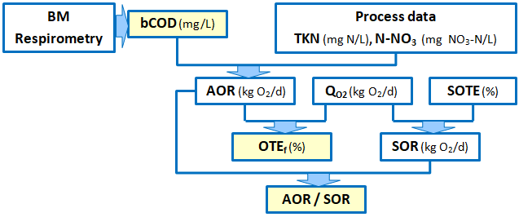
Essential parameters for evaluating a diffused aeration system
bCOD | Biodegradable COD (mg/L) - Automatically determined by BM respirometry -
Process data | Influent flow rate (m³/d), NTK to be removed (mg N/L), Nitrate to be removed (mg NO₃-N/L)
AOR | Actual oxygen requirement (kg O₂/d) = Q*bCOD (1-Y_{H})/1000 + 4.57*Q*TKN/1000 – 2.28*Q*NO₃-N
Q_{O2} | Oxygen flow rate supplied by the aeration system (kg O₂/d) = 6.84 * Q_{air} (Nm³/h)
SOTE | Standard oxygen transfer efficiency (%) - calculated from the curve provided by the manufacturer. Normally SOTE ≈ 6,5 * Diffusers depth (m)
SOR | Standard oxygen requirement (kg O₂/d) = Q_{O2} * SOTE
OTE_{f} | Oxygen transfer efficiency in the process (%) = 100 * AOR / Q_{O2}
AOR/SOR | Ratio for evaluation and follow up AOR/SOR reference for clean fine bubble systems = 0.33 AOR/SOR reference for clean coarse bubble systems = 0.5

Slide 43
SURCIS, S.L.
Teléfono: 932 194 595 / 652 803 255
E-mail: surcis@surcis.com / eserrano@surcis.com
Internet: www.surcis.com

