Slide 1
BM Respirometry System for essential COD fractionation in wastewater
1

Slide 2
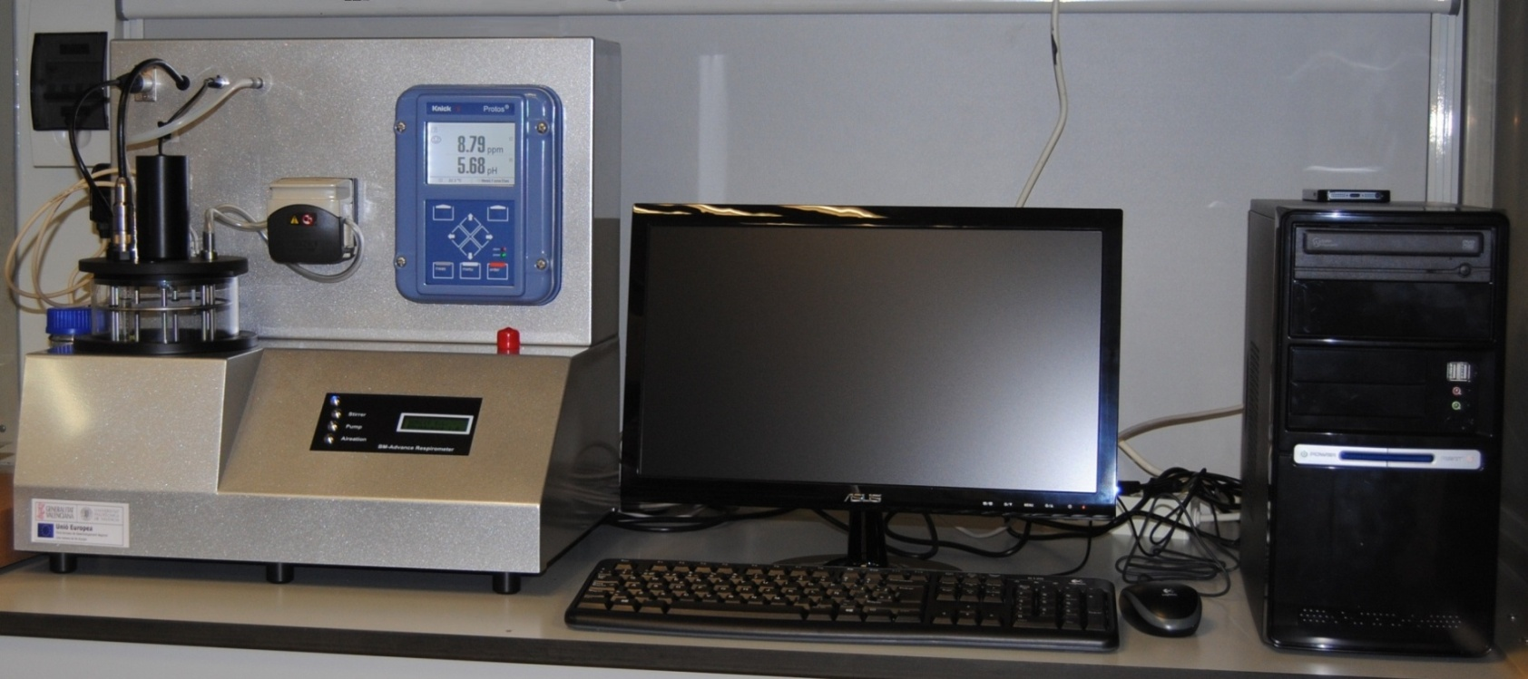
BM Multipurpose Respirometry System

Slide 3
BM Respirometry

Slide 4
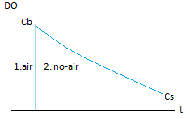
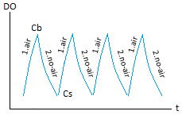
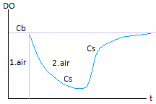
Three different operation modes
While most of the respirometers on the market offer only one operation mode, the BM respirometers have three different operation modes: OUR mode, Cyclic OUR mode, and R mode. Each mode develops different respirograms for automatic parameters including D.O., Temperature, and pH (in BM-Advance) from where specific applications can be made.
In a single batch reactor, the measuring system can work as LSS and LFS batch respirometry. The system is optimized by a one-sense membrane device, that together with a dividing plate, is able to isolate the measuring chamber and avoid bubbles against the DO sensor.
OUR | Cyclic OUR | R
This mode is making use of the LSS respirometry type. The OUR mode consists of a single test to measure the OUR and/or SOUR parameters (by manually setting the MLVSS concentration). It also has the option the get a partial SOUR for any period within the respirogram. | The cyclic OUR mode consists of a progressive sequence of OUR measurements, generated from the DO trajectory when it fluctuates between the DO. Low and DO. High set-points that were set at the start of the test. | The R mode corresponds to a modified LFS respirometry type test. The measuring system can be considered as a completely mixed batch reactor. In this mode, we get the important advantage to work with a small volume of samples in order to minimize the test time for an important package of several simultaneous parameters measurement.

Slide 5
Main automatic parameters in BM respirometer
for the different operations modes
OUR: Oxygen Uptake Rate (mg O₂/l.h)
It measures the oxygen uptake rate for only one measurement or serial o measurements.
SOUR: Specific OUR (mg O₂/g VSS.h)
Specific OUR related to MLVSS. SOUR = OUR / MLVSS
OUR
&
Cyclic OUR
Rs: Dynamic Respiration Rate (mg O₂/l.h)
It measures the oxygen uptake rate from the mixture of the activated sludge and certain amount of wastewater sample or compound within a continuous chain of measurements.
Rsp: Dynamic specific respiration Rate (mg O₂/g VSS.h)
Specific Rs referred to MLVSS. Rsp = Rs / MLVSS
bCOD: Biodegradable COD (mg O₂/l)
Biodegradable or soluble readily biodegradable COD fraction, based on Rs measurements integration from a mixture of activated sludge and biodegradable sample.
U: COD removal rate (mg COD/l,h)
Speed at which the COD is being removed.
q: Specific COD removal rate (mg COD/ mg VSS.d)
Specific U referred to MLVSS concentration.
BM Operation modes
R

Slide 6
Essential COD fractions

Slide 7
Wastewater Biodegradable and non-biodegradable COD fractions
COD fractions in the influent wastewater composition has a significant impact on the wastewater treatment operation and performance.
sbCOD (X_{S})
slowly biodegradable COD
bCOD
biodegradable COD
sbCOD = bCOD – rbCOD
rbCOD (S_{S})
readily biodegradable COD
COD
Total COD
nbCOD
non-biodegradable COD
nbCOD = COD – bCOD

Slide 8
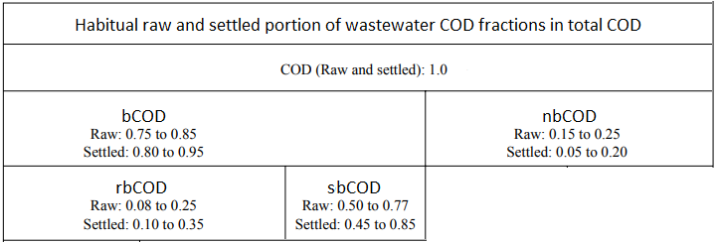
II. Wastewater biodegradable and non-biodegradable fractions
Note: Non-biodegradable COD = Unbiodegradble COD = Inert COD = Refractory COD

Slide 9
Why biodegradable COD rather than BOD ?
BOD only measures the organics used for respiration and ignores what is converted to bacterial biomass
BOD Ignores the unbiodegradable carbonaceous matter

Slide 10
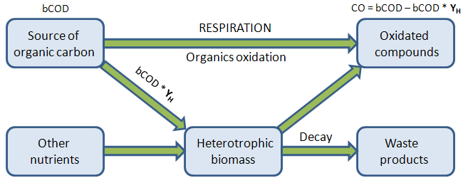
I. Yield coefficient of heterotrophic biomass
The Y_{H} is a fundamental parameter bt itself and for the bCOD and rbCOD fractions because it represents the part (percentage) of biodegradable COD that goes to the heterotrophic biomass growing
bCOD = CO / (1 – Y_{H})

Slide 11
Wastewater COD biodegradable fractions by BM Respirometery
From endogenous activated sludge and wastewater sample (non-filtered and soluble), the BM respirometer can automatically determine the biodegradable COD (bCOD) and readily biodegradable COD (rbCOD)
The automatic calculation is performed in base of the mathematical formula based on the Consumed Oxygen (CO) and Yield Coefficient (Y_{H})
From bCOD, rbCODs, total COD (COD) and soluble COD (sCOD), the main COD fractions can then be calculated.
Influent to biological reactor
non-filtered sample
R test in BM respirometer
bCOD = CO / (1 – Y_{H})
(automatic calculation)
bCOD
Activated sludge
under endogenous respiration
R test in BM respirometer
rbCOD = COs / (1 – Y_{H})
(automatic calculation)
rbCOD
S_{S}
Influente to biological reactor
soluble sample
Note: in case there is nitrification in the actual process, a dose of allyl-thiourea (ATU) must be added to the endogenous sludge before the test performance (normally 3 mg ATU per g of MLVSS)

Slide 12
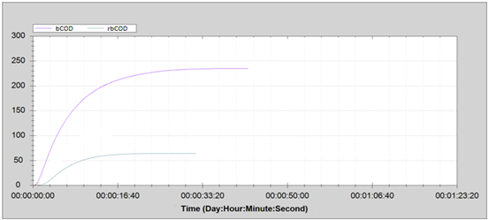
Essential COD fractions by BM Respirometry
bCOD & rbCOD
BM Respirometry R tests
bCOD
not filtered sample
rbCOD
truly soluble sample
bCOD and rbCOD respirograms in BM Respirometry
rbCOD (S_{S})
readily biodegradable COD
bCOD
biodegradable COD
sbCOD (X_{S})
slowly biodegradable COD
COD
Total COD
nbCOD
non-biodegradable COD
sbCOD = bCOD – rbCOD ǁ nbCOD = bCOD – rbCOD ǁ

Slide 13
Influence of COD fractions in the biological wastewater treatment

Slide 14
Influence of readily biodegradable COD (rbCOD)
High rbCOD within a high F/M, can lead the process towards a Bulking & Fomaing.
When the aeration tank is operating under limited oxygenation, a rbCOD with high COD uptake rate can provoke a dramatic fall of the dissolved oxygen level to zero ppm, creating an important anoxic zone in the process start and a possible septicity effect.
High rbCOD for a limited hidraulic retention time can develop a partial nitrification and risk of nitrite in the effluent.
The rbCOD, in the influent of the anoxic zone, is the carbonaceous material available for the facultative heterotrophic biomass to develop the denitrification process. For this reason, a lack of rbCOD will lead the process to a poor denitrification performance
Denitrification rate (NUR) is directly proportional to rbCOD uptake rate during nitrate oxydation.
For this reason, the denitrification rate is proportional to the rbCOD uptake rate (U)
Very low or very high rbCOD value can disable the advisable ratio of C/N/P = 100/5/1 for nutrients.
The respirometry bCOD test can detect the presence of any inhibior or toxic compound.
The bCOD is an essential parameter to be included in the actual oxygen requirement (AOR) and, with this, determine the corresponding AOR/SOR ratio in order to obtain a real evaluation of the aeration system and energy optimization.

Slide 15
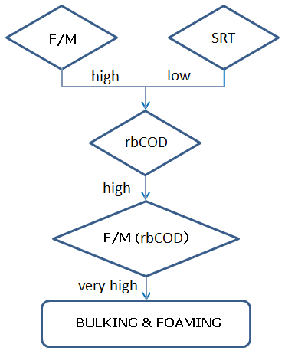
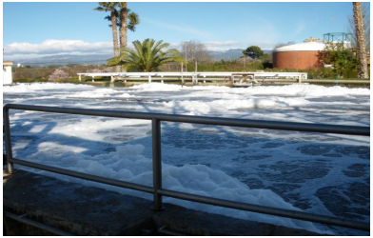
Impact of high rbCOD
When rbCOD is much higher than normal (>> 30%) together with a high F/M, it can generate an important bulking-foaming fenomena
F/M: Food/Microorganisms ratio (BOD/SS.d)
SRT: Sludge Retention Time (d)
F/M (rbCOD): F/M only related to rbCOD
White foam

Slide 16
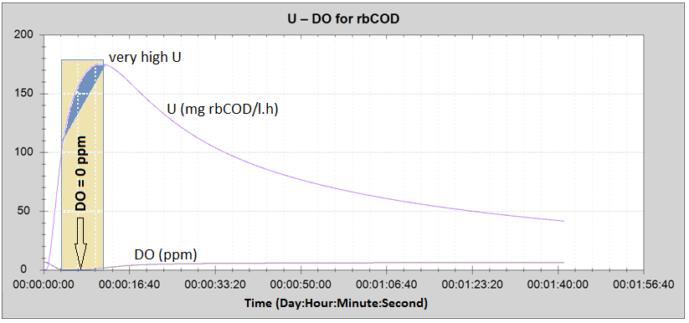
Impact of high rbCOD uptake rate (U) in the dissolved oxygen
F/M respirometer = 0,03
Simultaneous DO and U Respirograms in BM respirometer in R test for rbCOD determination
rbCOD with high substrate uptake rate rate (U) can conduct the dissolved oxygen to zero value at the start of the aerobic treatment process .
This effect, coming from the lack of oxygen, could create an unwanted anoxic zone which could leads the process towards a poor COD performance and possible septicity.

Slide 17
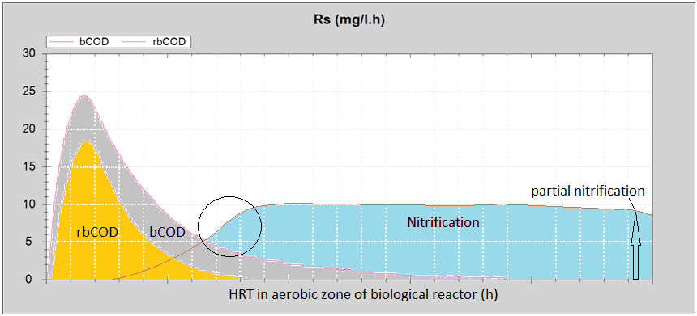
Impact of high rbCOD in the nitrification
For a process operation under limited DO, a high percentage of rbCOD in COD (> 30% of COD) delays the actual nitrification rate starts, making an important impact in the available nitrification time and conducting it to a possible partial nitrification.

Slide 18
The rule of rbCOD in the denitrification
The rbCOD, in the influent of the anoxic zone, should macth the soluble carbonaceous needs of the facultative heterotrophic biomass for the denitrification process.
Soluble carbonaceous matter / Nitrate = [ rbCOD (1 – 0.85 Y_{H.O2}) ] / [ N_NO₃d ] = 2,86 N_NO₃d (mg/l): Nitrate to denitrify
The Soluble carbonaceous matter / Nitrate should be equal or higher than 2,86 value.
When the carbonaceous matter / Nitrate ratio is lower than 2,86, the denitrification performance will be proportionally reduced.

Slide 19
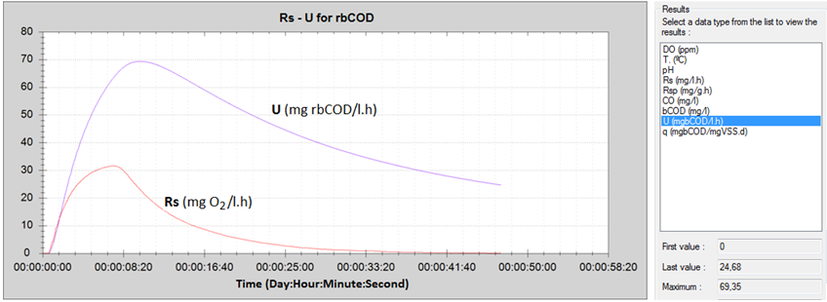
rbCOD utilization rate (U) in denitrification rate (NUR)
Denitrification develops the same speed as the rbCOD uptake rate during nitrate oxydation.
For this reason, the denitrification rate (NUR) is proportional to the rbCOD uptake rate (U) which is one of the simultaneous parameters that a BM respirometer can automatically calculate in the R test for rbCOD.
Simultaneous Rs and U Respirograms R test for bCOD determination in a BM respirometer
Denitrification rate : NUR = U (1 – 0.85 Y_{H.O2}) / 2,86
So, we can calculate the NUR from the U parameter, and check the necessary hydraulic retention time (T_{DN}) in the anoxic zone.
T_{DN} = N_NO₃d / NUR

Slide 20
Influence of the slowly particulate biodegradable COD
High value of sbCOD including very low specific COD uptake rate (e.g. FOG) can provoke a nutritional lack, leading the process to a filamentous bacteria generation and possible bulking fenomena.
When the HRT is very limeted, a high sbCOD could provoke a poor BOD performance.
For wastewater treatments not designed for nitrification, under certain conditions, a high value of sbCOD could lead the process to an unwanted nitrification.
BOD
BOD / N / P
COD
sbCOD

Slide 21
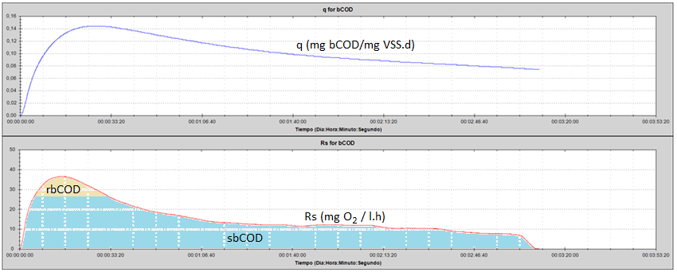
Impact of high slowly biodegradable COD (sbCOD)
and low specific substrate uptake rate (q)
When sbCOD is very high ( >> 70 % of COD) , together with a low specific substrate uptake rate (q), it can make a high impact in the activated sludge and lead the process to an important foaming & bulking state. :
q respiromgram for a typical example of high sbCOD
Simultaneous respirograms of q and Rs for bCOD determination in a BM respirometer
On those conditions, the biomass can experiment a dramatic nutritional lack, leading the sludge to an important defloculation and very poor performance.

Slide 22
Influence of the non-biodegradable COD
High percentage of nbCOD (>> 25% of COD) can lead the process to a poor performance by getting COD levels out of limits in the effluent.
When the nbCOD includes a high percentage of particulate portion (nbpCOD), the sludge production can be dramatically increased.
When the nbCOD includes a high percentage of soluble portion (nbsCOD) it could be a possible lack of soluble biodegradable COD (rbCOD) for the denitrification.

Slide 23
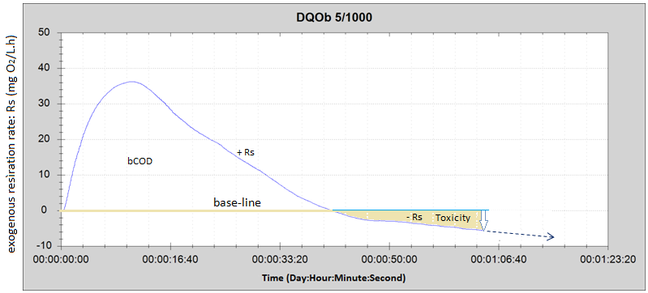
Toxicity detection during a bCOD test
The dCOD test can detect the presence of any inhibitor or toxic compound when the trajectory of the positive respiration rate (+ Rs) crosses the baseline, corresponding to the endogeneous respiration level) passing into a chain of negative values (- Rs) within a progressive negative slope.
Negative Rs values under negative slope means a significative active biomass concentration reduction.
In that condition, the bCOD value becomes lower than normal due to loss of oxygen demand (area below baseline)

Slide 24
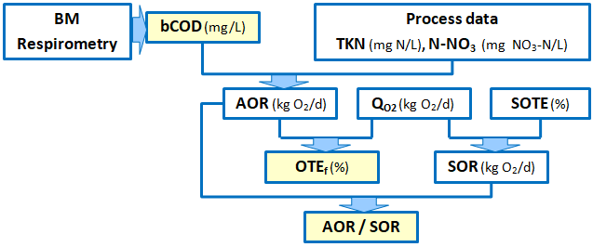
Essential parameters for evaluating a diffused aeration system
bCOD | Biodegradable COD (mg/L) - Automatically determined by BM respirometry -
Process data | Influent flow rate (m³/d), NTK to be removed (mg N/L), Nitrate to be removed (mg NO₃-N/L)
AOR | Actual oxygen requirement (kg O₂/d) = Q*bCOD (1-Y_{H})/1000 + 4.57*Q*TKN/1000 – 2.28*Q*NO₃-N
Q_{O2} | Oxygen flow rate supplied by the aeration system (kg O₂/d) = 6.84 * Q_{air} (Nm³/h)
SOTE | Standard oxygen transfer efficiency (%) - calculated from the curve provided by the manufacturer. Normally SOTE ≈ 6,5 * Diffusers depth (m)
SOR | Standard oxygen requirement (kg O₂/d) = Q_{O2} * SOTE
OTE_{f} | Oxygen transfer efficiency in the process (%) = 100 * AOR / Q_{O2}
AOR/SOR | Ratio for evaluation and follow up AOR/SOR reference for clean fine bubble systems = 0.33 AOR/SOR reference for clean coarse bubble systems = 0.5

Slide 25
SURCIS, S.L.
www.surcis.com

